Slide 1

OGF HPC Basic Profile Interoperability Demonstrator
GIN-CG
Ismael Carrion (IGE), Steve Crouch (IGE), Andrew Grimshaw (GEN/FG), Chris Koeritz (GEN/FG), Mariusz Mamonski (QCG), Shahbaz Memon (EMI), Emmanouil Paisios (IGE), Marcin Pospieszny (IGE), Marius Mamonski (QCG), Morris Riedel (EMI), Gabor Roczei (EMI/NG), Karolina Sarnowska-Upton (GEN/FG), Oxana Smirnova (EMI/NG)

Slide 2

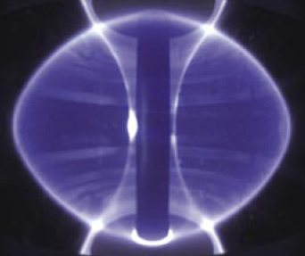
Introduction
Motivation
  Scientific requirements for compute always increasing
  Don’t always have enough local institution compute capacity
  EU has plentiful compute resources
  …but heterogeneous middlewares!
  How to efficiently and effectively use them to access and use more compute?
OGF HPC-Basic Profile Interoperability Demonstrator
  Illustrates what is possible now
  Based on years of Open Grid Forum effort to standardise compute – HPC-BP
  Grid Interoperability Now (GIN-CG)
Application:
  Physics: Plasma Charge Minimization
  Total system energy minimization of point charges around the surface of a sphere

Slide 3
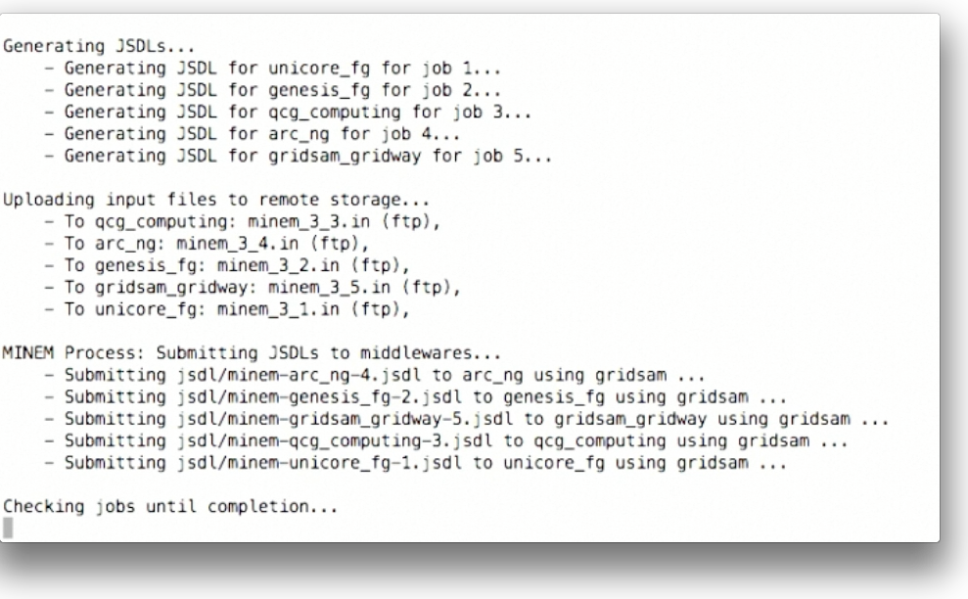
History
Initially shown at OGF27, Banff, Canada, Oct 09
SuperComputing, Nov 09, Nov 2010, Nov 2012
ETSI Plugtests, FZJ, UK AHM, Dec 09
OGF28, OGF30, OGE34, OGF36
Demonstrators: David Wallom, Peter Stefan, Morris Riedel, Shahbaz Memon, Oxana Smirnov, Steve Crouch
Notes:
Thanks to participants, we’ve all gained a lot of experience with interop

Slide 4
Standards, Data & Security Support
Standards:
  HPC Basic Profile v1.0
    OGSA BES (Basic Execution Service) v1.0
    JSDL (Job Submission Description Language) v1.0
    HPC Profile Application Extension v1.0
  HPC File Staging Profile v1.0
Data protocols used is ftp
  Only suitable common protocol across all platforms!
Security:
  Direct middleware -> certificate CA trust (just import CAs)

Slide 5
Client/Service Compatibility
Middleware | BES++ Client |  | GridSAM Client
 | Invocation | Application | Invocation | Application
ARC (EMI-2, FutureGrid) |  |  |  | 
BES++ | - | - |  | 
Genesis II (FutureGrid) | (w.sol.) | (w.sol.) |  | 
GridSAM+GridWay (IGE v3.0) |  |  | - | -
Microsoft Compute.Clus. |  |  | 
RENKEI |  |  | (w.sol.) | (w.sol.)
QCG Computing |  |  |  | 
UNICORE (EMI-2, FutureGrid) |  |  |  | 
VENUS-BES |  |  | (w.sol.) | (w.sol.)
Notes:
w.sol = working solution, in progress.
Note FutureGrid is a contributor of resources to XSEDE.
Those in bold are included in the demo video.
Invocation – being able to use standards to launch jobs and monitor them
Application – able to get the application running successfully to completion
Improvements since OGF36, October 2012:
- ARC from EMI-2 is now included
- QCG Computing in now included, the successor to SMOA Computing from PSNC.

Slide 6
Endpoint Preparation
Application provision on resource
Data resource (file staging)
Security
‘Practical’ JSDL
Iterative testing

Slide 7





















How Interop Demo Fits Together…
HPC-BP¹
Minem
1. Create Minem input files
Minem
4
5
2. Generate JSDLs from template
1
7
FTP
2
minem-interop.pl
HPC-BP²
Minem
3. Upload input files
4. Submit JSDLs across middlewares
FTP
3
5. Monitor jobs until completion
GridSAM
Client
FTP
HPC-BP³
Minem
6. Download output files
7. Select best result
6
8
8. Generate output image from results
FTP
Client
Job Service
HPC-BP⁴
Minem
Data Service
Application
Security Service
…
Notes:
This is not fully inclusive of all types of endpoints, but shows the general idea.

Slide 8
Time for the Demo!

Slide 9
Future Work
Bring in other endpoint types and production grids
  Volunteer your HPC Basic Profile-compliant service!
  Extra points if service on a production grid!
  XSEDE!
  -> SkifGrid, Belarus; UNICORE on PRACE
Go beyond FTP for data transfer
  Only data protocol supported by all middlewares
  This is changing (GridFTP e.g. UNICORE, GridSAM)
  -> Also GridFTP on ARC, Genesis II as well now
Another application?
  Currently use Minem, but suggestions welcome!
  -> Perhaps Haddock (molecular dynamics)

Slide 10
Future Work
Capture lessons learned
  History of endpoint use (Wiki use)
  Security
  Maturity of spec & trust
    JSDL
    BES
  Job execution
  Data staging
  Socio-technical (i.e. managing participation!)
  Errors and resolution
  Applications (Minem – core, half-page on BES with e.g. Peter Coveney, BES/Kepler, OMII-Europe, etc.)
  …
Doc-based tutorial/how-to
  Based on http://www.omii.ac.uk/wiki/HPCBPTutorial
Code clean-up and upload to Redmine
XSEDE – contribute this work to their endpoint testing?

